Slide 1


Advanced DS
Data Structure and Algorithms
Fall 2025
Red Black Tree
eduko.spikotech.com
University of Engineering and Technology Lahore Pakistan

Slide 2
Self-Balancing Binary Search Trees

Slide 3
Idea 1: Rotations
No matter what lives underneath A,B,C, this takes time O(1). (Why?)
Maintain Binary Search Tree (BST) property, while moving stuff around.
Note: A, B, C, X, Y are variable names, not the contents of the nodes.
X
Y
Y
YOINK!
Y
C
A
B
X
A
X
A
B
C
B fell down.
B
C
That’s not binary!!
CLAIM:
this still has BST property.

Slide 4
This seems helpful
3
YOINK!
5
2
5
3
7
4
7
2
4
6
8
6
8

Slide 5
Strategy?
Whenever something seems unbalanced, do rotations until it’s okay again.
Even for Lucky this is pretty vague. What do we mean by “seems unbalanced”? What’s “okay”?
Lucky the Lackadaisical Lemur

Slide 6
Idea 2: have some proxy for balance
Maintaining perfect balance is too hard.
Instead, come up with some proxy for balance:
If the tree satisfies [SOME PROPERTY], then it’s pretty balanced.
We can maintain [SOME PROPERTY] using rotations.
There are actually several ways to do this, but today we’ll see…

Slide 7
RB Tree Introduction
CLRS Chapter 13 (13.1)

Slide 8
Red-Black Trees
A Binary Search Tree that balances itself!
No more time-consuming by-hand balancing!
Be the envy of your friends and neighbors with the time-saving…
Red-Black tree!
5
3
7
Maintain balance by stipulating that black nodes are balanced, and that there aren’t too many red nodes.
2
4
6
8
It’s just good sense!

Slide 9
Red-Black Trees obey the following rules (which are a proxy for balance)
Every node is colored red or black.
The root node is a black node.
NIL children count as black nodes.
Children of a red node are black nodes.
For all nodes x:
all paths from x to NIL’s have the same number of black nodes on them.
5
3
7
2
4
6
8
I’m not going to draw the NIL children in the future, but they are treated as black nodes.
NIL
NIL
NIL
NIL
NIL
NIL
NIL
NIL

Slide 10
Examples(?)
Every node is colored red or black.
The root node is a black node.
NIL children count as black nodes.
Children of a red node are black nodes.
For all nodes x:
all paths from x to NIL’s have the same number of black nodes on them.
Which of these
are red-black trees?
(NIL nodes not drawn)
Yes!
1 minute think
1 minute pair+share
No!
No!
No!

Slide 11
Why these rules???????
5
This is pretty balanced.
The black nodes are balanced
The red nodes are “spread out” so they don’t mess things up too much.
We can maintain this property as we insert/delete nodes, by using rotations.
3
7
2
4
6
8
9
This is the really clever idea!
This Red-Black structure is a proxy for balance.
It’s just a smidge weaker than perfect balance, but we can actually maintain it!

Slide 12
This is “pretty balanced”
Let’s build some intuition!
Lucky the lackadaisical lemur
To see why, intuitively, let’s try to build a Red-Black Tree that’s unbalanced.
One path can be at most twice as long another if we pad it with red nodes.
Other internal nodes need to go here!
Conjecture:
the height of a red-black tree
with n nodes is at most 2 log(n)

Slide 13
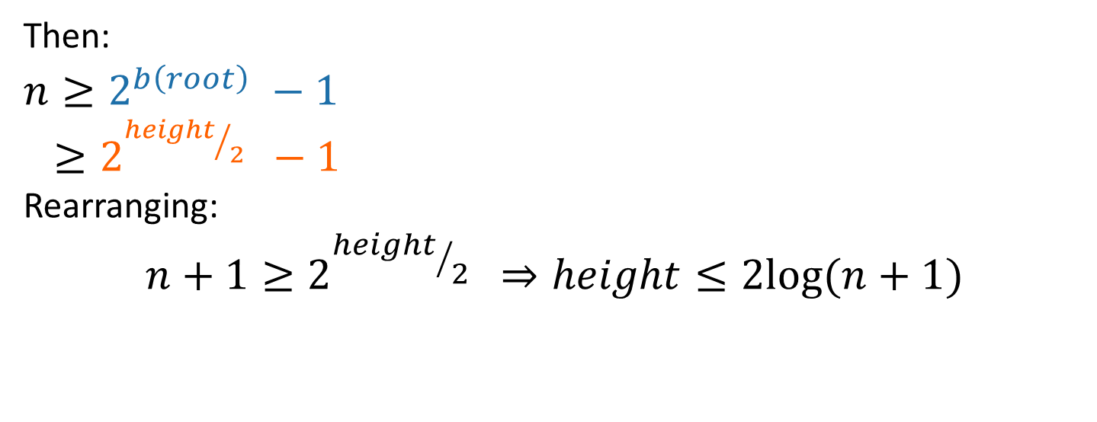

The height of a RB-tree with n non-NIL nodes is at most $2log⁡(n+1)$
x
Define b(x) to be the number of black nodes in any path from x to NIL.
(excluding x, including NIL).
Claim:
There are at least 2^{b(x)} – 1 non-NIL nodes in the subtree underneath x. (Including x).
[Proof by induction – on board if time]
y
z
NIL
Claim: at least 2^{b(x)} – 1 nodes in this WHOLE subtree (of any color).
Then:
$$n≥2^{b\left(root\right)} −1$$
$≥2^{{height}/2 } −1$
Rearranging:
$$n+1≥2^{{height}/2 } ⇒height≤2log⁡(n+1)$$
using the Claim
b(root) >= height/2 because of RBTree rules.

Slide 14
This is great!
SEARCH in an RBTree is immediately O(log(n)), since the depth of an RBTree is O(log(n)).
What about INSERT/DELETE?
Turns out, you can INSERT and DELETE items from an RBTree in time O(log(n)), while maintaining the RBTree property.
That’s why this is a good property!

Slide 15
Rotation
CLRS Chapter 13 (13.2)

Slide 16
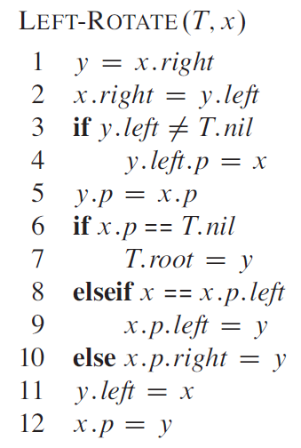
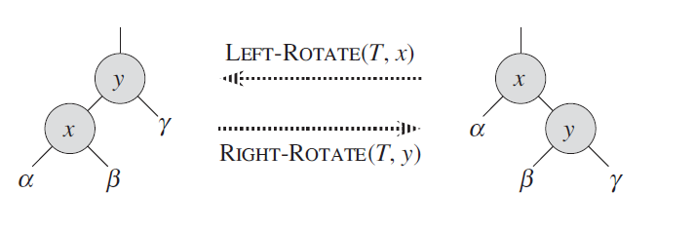
Rotations

Slide 17
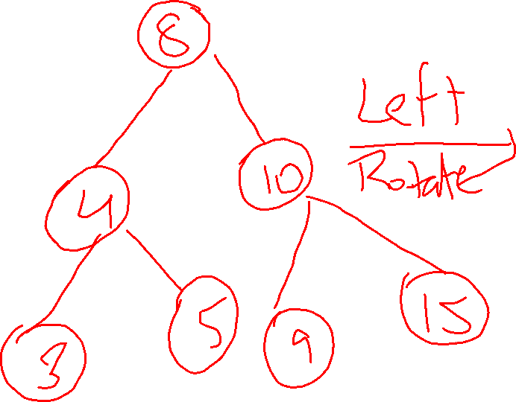

Slide 18


Slide 19
Tree Insertion
CLRS Chapter 13 (13.3)

Slide 20
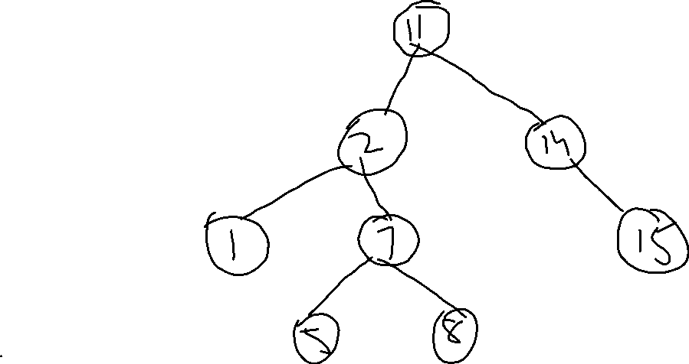
Case 1: Z’s uncle is red

Slide 21
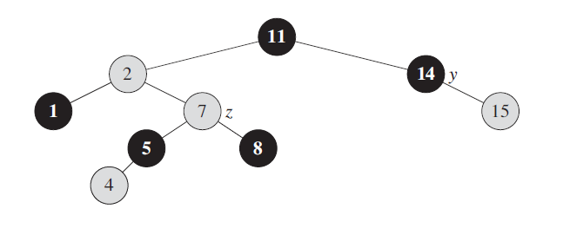
Case 2: Z’s uncle is Black is z is right child

Slide 22
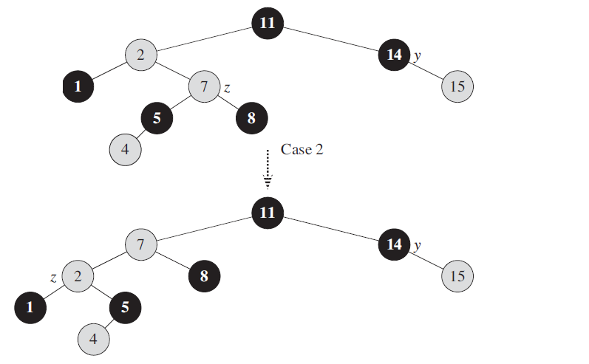

Slide 23
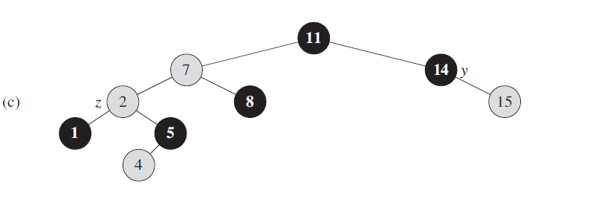
Case 3: Z’s Uncle is Black and Z is left child

Slide 24
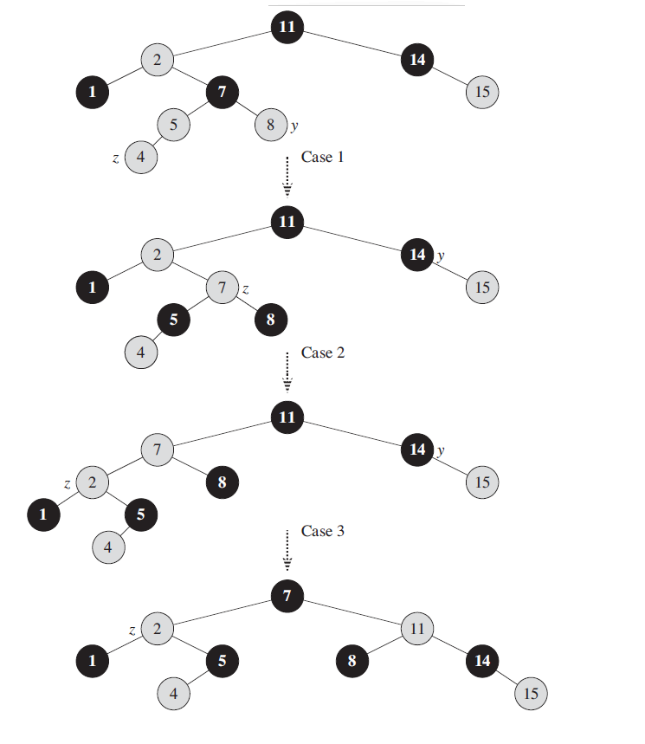

Slide 25
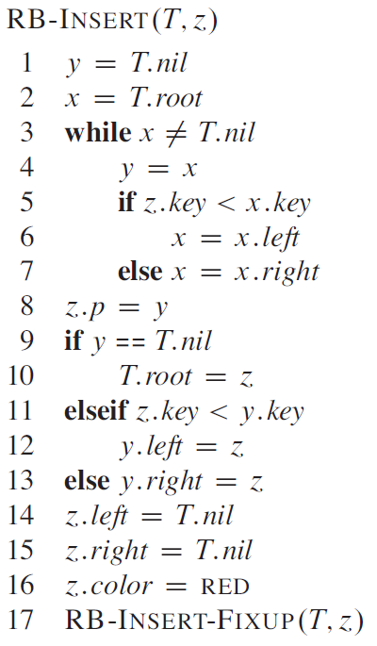
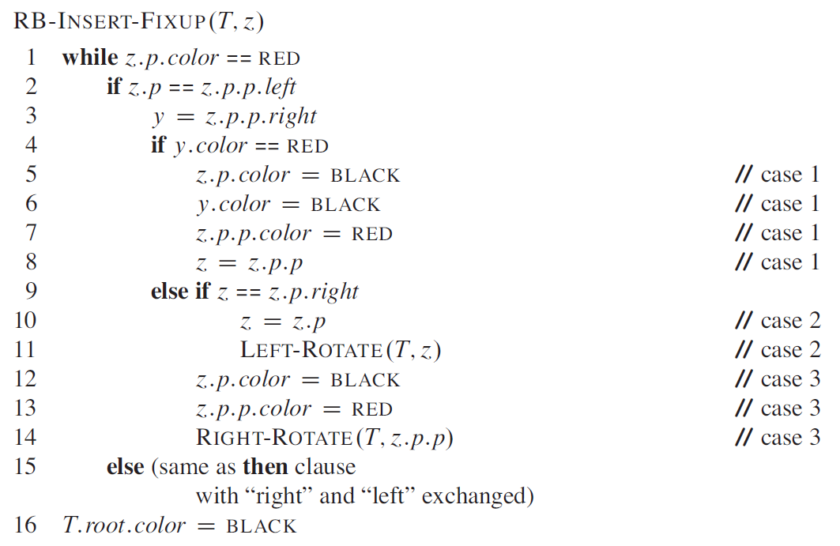
Tree Insert

Slide 26
Deletion
CLRS Chapter 13 (13.4)

Slide 27
Deleting from a Red-Black tree
Fun exercise!
Ollie the over-achieving ostrich

Slide 28
What have we learned?
Red-Black Trees always have height at most 2log(n+1).
As with general Binary Search Trees, all operations are O(height)
So all operations with RBTrees are O(log(n)).

Slide 29
Conclusion: The best of both worlds
 | Sorted Arrays | Linked Lists | Binary Search Trees*
Search | O(log(n)) | O(n) | O(log(n))
Delete | O(n) | O(n) | O(log(n))
Insert | O(n) | O(1) | O(log(n))

Slide 30
Thank You

